Slide 1

Attrition data
analysis

Slide 2
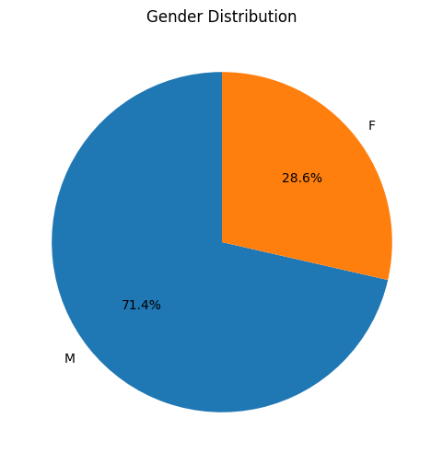

Gender Distribution Representation
There are more male entertainers than female entertainers in the provided dataset.
The entertainment industry may have a gender imbalance, as the data suggests that there are more male entertainers than female entertainers.

Slide 3
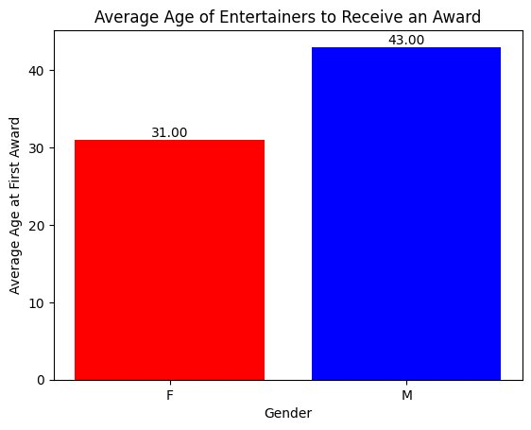
Average Age Of Entertainers To Receive Award
On average, female entertainers tend to receive their first major award (Oscar, Grammy, or Emmy) at a younger age compared to their male counterparts.
This suggests there might be factors influencing earlier recognition and success for women in the entertainment industry.
Further analysis could explore potential reasons for this difference, such as societal expectations, industry biases, or varying career trajectories for men and women.

Slide 4
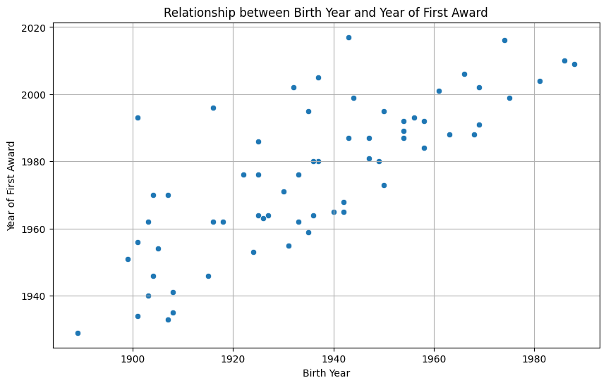
Age Gap Between Birth Year and
Year of First Award
The scatter plot indicates a wide range of ages at which entertainers receive their first major awards.
There is no clear linear correlation between birth year and year of first award, suggesting that success in the entertainment industry is influenced by various factors beyond just age.
While age may play a role in an entertainer's career trajectory, it is not the sole determinant of success.
Factors such as talent, dedication, opportunity, and networking likely contribute significantly to an individual's breakthrough in the competitive world of entertainment.

Slide 5
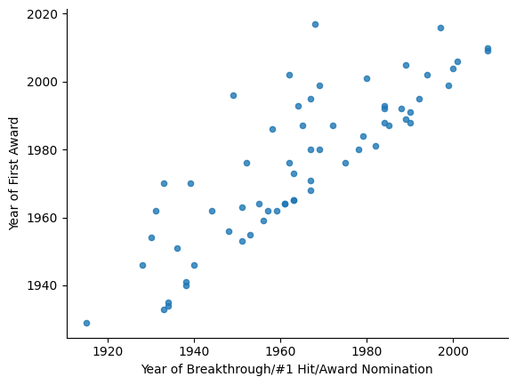

Year Of Breakthrough/1 Hit/Award Nomination Vs Year Of First Award
We can observe a positive correlation between the year of breakthrough and the year of first award.
This suggests that entertainers who achieve a breakthrough or a significant accomplishment earlier in their careers tend to receive their first major award sooner.
Early success can be a strong predictor of future achievements and recognition in the entertainment industry.

Slide 6
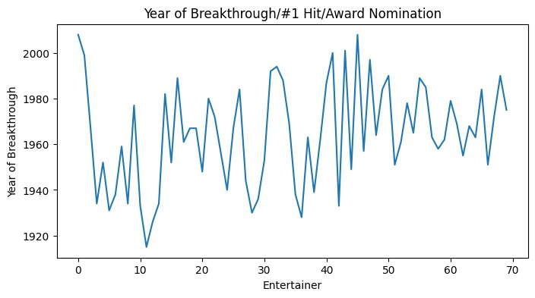


Entertainers’ Age At First Award
[
[
The upward trend suggests a potential shift towards earlier breakthroughs in recent years, possibly influenced by evolving media landscapes and audience dynamics.
Early peaks are followed by declines, with notable variability in the mid-20th century.
A high concentration of breakthroughs occurs around the 1980s-1990s, while recent years show more consistency.
There is a general upward trend in the year of breakthrough over time, suggesting that more recent entertainers tend to achieve their breakthrough moments earlier in their careers. This could be due to various factors such as increased exposure through social media and the internet, allowing for quicker recognition and fame.

Slide 7
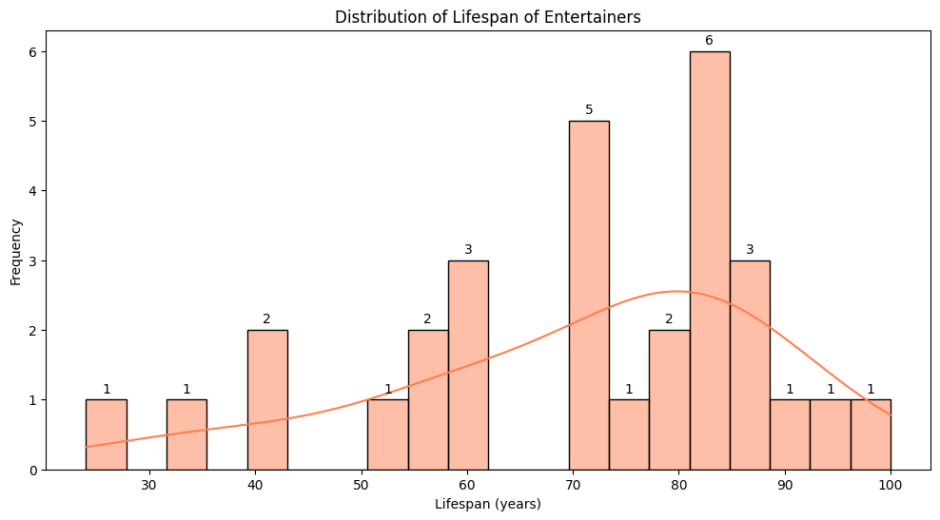
LIFESPAN OF ENTERTAINERS
[{{{{{{
The histogram illustrates the distribution of lifespans among the entertainers in the dataset.
It provides a visual representation of how long entertainers typically live.
By analyzing this chart, one can gain insights into the average lifespan of entertainers, identify any potential outliers, and understand the overall distribution of longevity in the entertainment industry.
This information could be valuable for various purposes, such as actuarial studies or historical analyses.

Slide 8
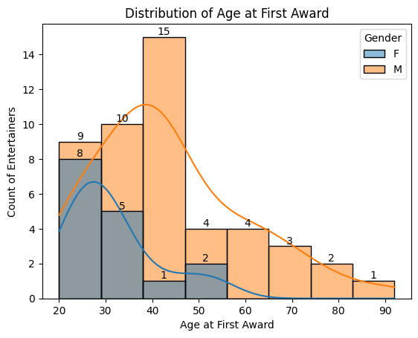
Age At First Award
Peak Ages: Most males (M) receive their first award around age 40, while females (F) peak at age 30.
Distribution Spread: Males show a wider age range at first award, extending into older ages.
Early Recognition: Females tend to receive awards earlier, with notable counts in their 20s and 30s.
Late Recognition: Males are more likely to receive awards later, even beyond age 70.

Slide 9
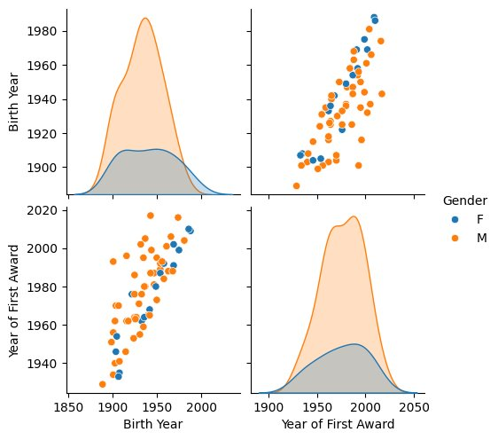
Correlation Between Birth Year & Year Of First Award By Gender
Birth Year Clustering:
Most males (M) were born between 1940-1960, showing a distinct peak. Females (F) have a more even spread, with a minor peak around the 1950s.
Award Year Trends:
Males received most awards between 1980-2000, with a significant concentration. Females have fewer awards with no sharp peaks, indicating diverse recognition times.
Positive Correlation:
Both genders show a strong positive correlation between birth year and year of first award, indicating that younger generations are achieving recognition earlier.
Historical Context:
The data encompasses a wide historical range, from the late 19th to the early 21st century, highlighting changes in recognition patterns over time.

Slide 10

Conclusion
This analysis has provided valuable insights into the careers and demographics of a group of entertainers.
We observed the distribution of genders, calculated the average age at which entertainers receive their first major award, and explored the relationship between birth year, year of breakthrough, and year of first award.
Notably, we found that male entertainers tend to receive their first major award slightly earlier than their female counterparts.
The distribution of lifespans provided a glimpse into the longevity of careers in the entertainment industry.
Further research could delve deeper into the factors contributing to the observed trends, such as genre, type of entertainment, and socio-cultural influences. This could help us better understand the dynamics of success and longevity in the entertainment world.

